Slide 1
CSE 12 – Basic Data Structures and Object-Oriented Design Lecture 18
Greg Miranda & Paul Cao, Winter 2021
This lecture is being recorded

Slide 2

Announcements
Quiz 18 due Monday @ 8am
Survey 7 due tonight @ 11:59pm
PA7 due Tuesday, March 2nd @ 11:59pm
Exam 2 – Week 8
Released Friday 2/26 @ 8am
Due Saturday 2/27 @ 10am
Topics:
Cumulative
Big topics
Big O, Big Theta run-time analysis
Sorting algorithms
Hash tables/maps

Slide 3
Topics
Binary Search Trees
Questions on Lecture 18?

Slide 4
class Node<K,V> {
K key;
V value;
Node<K,V> left;
Node<K,V> right;
public Node(K key, V value,
Node<K,V> left,
Node<K,V> right) {
this.key = key;
this.value = value;
this.left = left;
this.right = right;
}
}
class BST<K, V> {
Node<K, V> root;
BST() (this.root = null);
BST(Node<K, V> root) { this.root = root; }
V get(Node<K, V> node, K key) {
if (node == null) { //throw error }
if (node.key.equals(key)) {
return node.value;
}
if (node.key > key) {
return get(node.left, key);
}
else {
return get(node.right, key);
}
}
V get(Key key) {
return this.get(root, key);
}
}

Slide 5
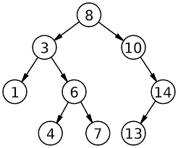
Binary Search Tree
Assume the key and value are identical for this example
Trace the path for get(4)
How many nodes does it touch?
Trace the path for get(2)
How many nodes does it touch?
What happens when the nodes isn’t found?

Slide 6
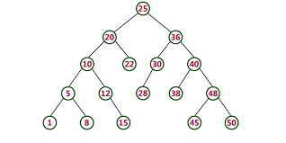
Binary Search Tree
Assume the key and value are identical for this example
Trace the path for get(40)
How many nodes does it touch?
Trace the path for get(4)
How many nodes does it touch?

Slide 7
Questions on Lecture 18?

